Slide 1
Mental Illness Awareness Project
NEXT

Slide 2
There are many different types of mental illnesses.
NEXT

Slide 3
NEXT

Slide 4
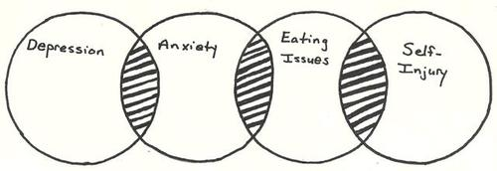
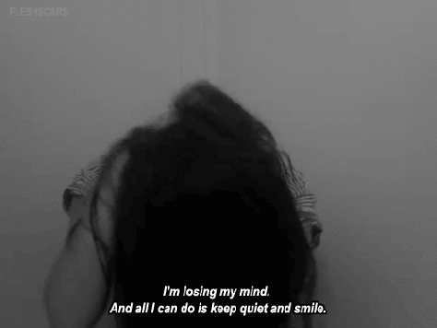
NEXT

Slide 5
Each person is different and will have unique symptoms, but here are some of the more common symptoms of depression:
Feelings of: - sadness - loss - guilt - worthlessness - extreme impatience - irritability - short temper
Recurring thoughts of suicide or self-harm
Withdrawal from friends and family
Loss of interest or pleasure in usually enjoyed activities
Constantly feeling tired, lack of motivation, anxiety and restlessness, sometimes leading to panic attacks
Muscle and joint pain, constipation or other intestinal problems, frequent headaches
Reduced ability to think clearly or make decisions and causes difficulties in concentrating or with short term memory loss
Changes in weight or appetite and sleeping patterns like insomnia
Lack of interest in sex
NEXT

Slide 6
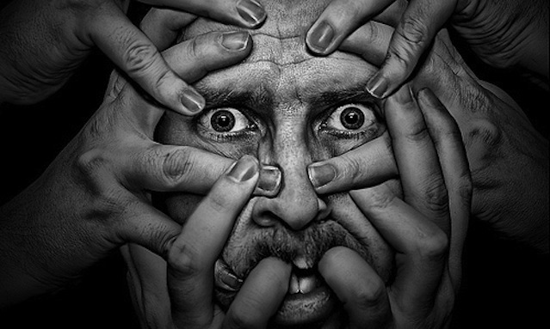
Factors and Contributions
NEXT

Slide 7
Social Media
Social media tells teenagers that they have to look and be a certain way in order to be successful.
Hey girls, according to society if you don’t look like this chick you aren’t considered beautiful or worth a mans time.
NEXT

Slide 8
Social Media
It is because of this idea that teenagers feel like failures and not good enough, this idea of the perfect woman is a contributing factor to depression.
NEXT

Slide 9
Stress
NEXT

Slide 10
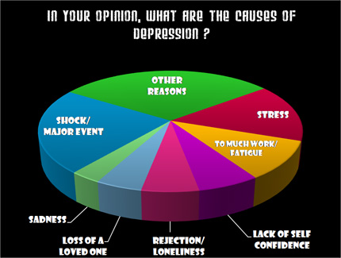
NEXT

Slide 11
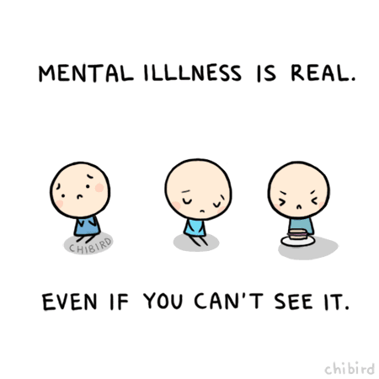
NEXT

Slide 12
Facts & Statistics
NEXT

Slide 13
Mental illness indirectly affects all Canadians at some time through a family member, friend or colleague.
20% of Canadians will personally experience a mental illness in their lifetime.
Mental illness affects people of all ages, educational and income levels, and cultures.
Approximately 8% of adults will experience major depression at some time in their lives.
About 1% of Canadians will experience bipolar disorder (or “manic depression”).
Facts & Statistics
NEXT

Slide 14
Once depression is recognized, help can make a difference for 80% of people who are affected, allowing them to get back to their regular activities.
The total number of 12-19 year olds in Canada at risk for developing depression is a staggering 3.2 million.
Today, approximately 5% of male youth and 12% of female youth, age 12 to 19, have experienced a major depressive episode.
Facts & Statistics
NEXT

Slide 15
Sometimes it leads to suicide. Fortunately, for most people, depression can be treated effectively.
Depression can limit your quality of life, affect relationships, lead to lost time from work or school and contribute to other chronic diseases such as diabetes and heart diseases.
About 11% of men and 16% of women in Canada will experience major depression in the course of their lives.
One year prevalence of depression:
major depression - 4.8%
bipolar disorder - 1.0%
Facts & Statistics
NEXT

Slide 16
Lifetime prevalence rates vary but have been reported
between 2% and 19%, 9, 13, 14, in Canadian adults over 18 years, speciﬁcally, lifetime prevalence rates are about 12%.1
Approximately 2%-6% of the general population will
experience major depression in any 12-month period.
More than 50% of individuals who experience one major
depressive episode suffer from a recurrent episode
Facts & Statistics
NEXT

Slide 17
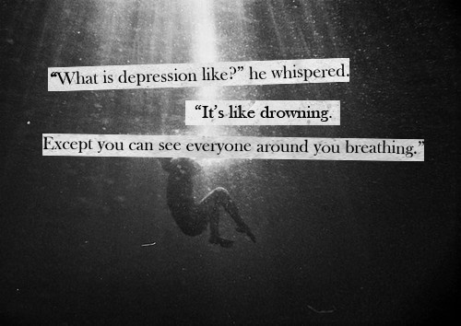
“I didn't want to wake up. I was having a much better time asleep. And that's really sad. It was almost like a reverse nightmare, like when you wake up from a nightmare you're so relieved. I woke up into a nightmare.” ― Ned Vizzini, It's Kind of a Funny Story
How does Depression feel?
NEXT

Slide 18
Treatment
NEXT

Slide 19
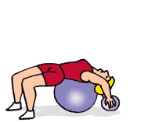
Treatment
Lifestyle changes that can treat depression
Exercise
Regular exercise can be as effective at treating depression as medication. Not only does exercise boost serotonin, endorphins, and other feel-good brain chemicals, it triggers the growth of new brain cells and connections, just like antidepressants do.
NEXT

Slide 20
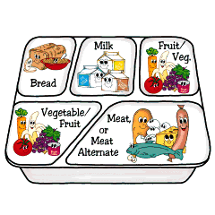
Treatment
Nutrition
Eating well is important for both your physical and mental health.
Eating small, well-balanced meals throughout the day will help you keep your energy up and minimize mood swings.
NEXT

Slide 21
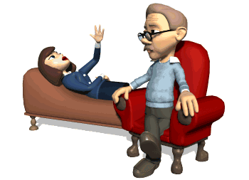
Treatment
Social Support
Strong social networks reduce isolation, a key risk factor for depression.
Keep in regular contact with friends and family, or consider joining a class or group.
Volunteering is a wonderful way to get social support and help others while also helping yourself.
NEXT

Slide 22
Treatment
Stress reduction
Make changes in your life to help manage and reduce stress.
Too much stress exacerbates depression and puts you at risk for future depression.
Take the aspects of your life that stress you out, such as work overload or unsupportive relationships, and find ways to minimize their impact.
NEXT

Slide 23
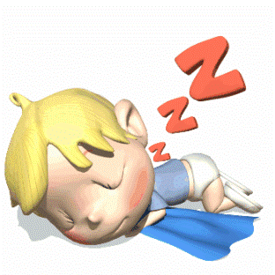
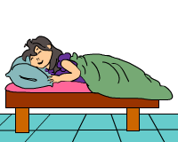
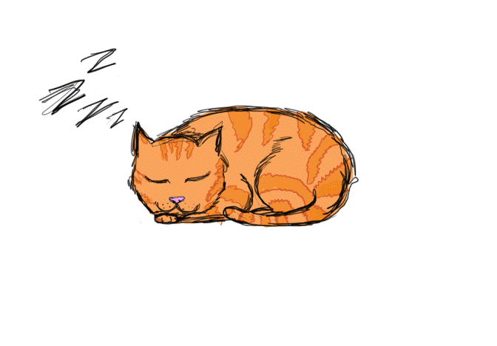
Treatment
Sleep
When you don't get enough sleep, your depression symptoms will be worse.
Sleep deprivation exacerbates irritability, moodiness, sadness, and fatigue.
Make sure you're getting enough sleep each night. Aim for somewhere between 7 to 9 hours each night.
NEXT

Slide 24
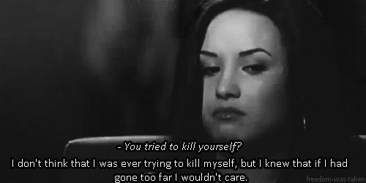
This is an important issue because depression can lead to suicide
NEXT

Slide 25
Don’t be afraid to reach out to get help if you think you need it. There’s no need to feel ashamed or uncomfortable. There are people across the country ready to help you, many of whom have been in circumstances like yours and can personally relate.
If you need help right away:
Visit your local emergency department or call 911
Contact a crisis centre
Contact Kids Help Phone (1-800-668-6868) or go online (kidshelpphone.ca). To reach a Kids Help Phone professional counselor from any community in Canada, call 1-800-668-6868 or go online at kidshelpphone.ca at any time.
Canada’s only free, national, bilingual, anonymous and confidential phone and online professional counseling service for youth (for ages 20 and under). They have access to a database of over 37,000 local resources and deal with big or small concerns, 24/7, 365 days a year.
Get Help
NEXT

Slide 26
Other immediate resources include:
Call 211 if you are in Alberta (Calgary, Edmonton), British Columbia, Ontario or Quebec
Provides free, confidential, multilingual access to information about the full range of community, social, health and government services in your area.
All 211 calls are answered by live operators who assess each caller’s needs and link them to the best available services and programs, 24 hours a day, seven days a week.
Visit www.eMentalHealth.ca
eMentalHealth.ca provides a directory of mental health assistance, resources and events sorted by province and community. It offers anonymous, confidential and trustworthy information, 24 hours a day, 365 days a year.
Contact your local health clinic or local hospital that provides mental health services.
Contact your local chapter of the Canadian Mental Health Association: www.cmha.ca
Check the front page of your telephone book for a phone number of a crisis hotline or community service referral agency.
Get Help
NEXT

Slide 27
Additional resources information
Family doctor: A family doctor is often a good place to start. He or she can help you find professional help. With a little preparation, you can get the most out of your visit.
Psychiatrist: A psychiatrist is a medical doctor specially trained in the diagnosis and treatment of mental illnesses. He/she may treat your problems with medication or by psychotherapy (sometimes called "talk therapy"), or a combination of both. Your family doctor may give you a referral.
Psychologist: A psychologist has an advanced degree from a university but not a medical degree. He/she will use counseling and other methods that do not involve the use of medications.
Social Worker: Social workers provide services as members of a multidisciplinary team or on a one-to-one basis with the client, depending on the settings in which they work. They may provide counselling, psychotherapy, rehabilitative or assessment services, or provide referrals to the appropriate services.
Peer Support / Self-Help Group: for many people living with mental illness, self-help and peer support can be important elements of recovery because of the support they can offer through shared experiences. To find out if there’s a local self-help or peer support group that can meet your needs, contact your local Canadian Mental Health Association branch (www.cmha.ca) or another community agency.
Get Help
NEXT

Slide 29
"Fast Facts about Mental Illness." Canadian Mental Health Association. Ed. CMHA. CMHA Publications, n.d. Web. 12 May 2014.
Freshwater, Dawn. Mental Health and Illness: Questions and Answers for Counsellors and Therapists. Chichester, West Sussex, England: Whurr, 2006. Print.
Bibliography
DONE

