Slide 1
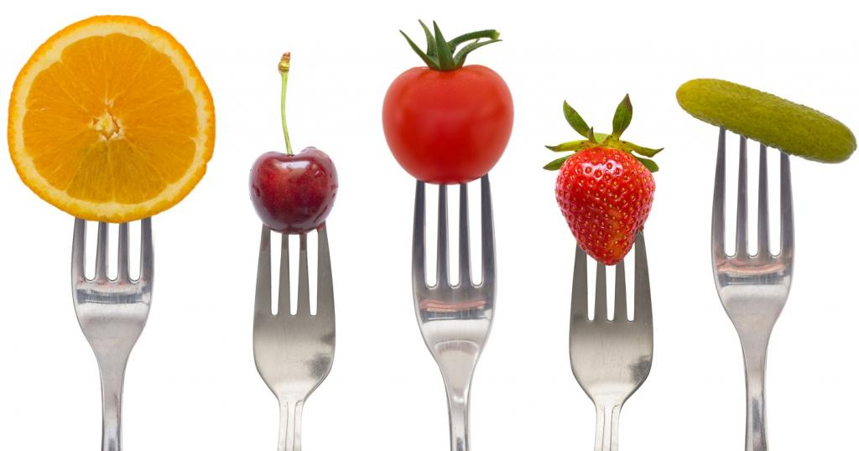
Healthy Eating

Slide 2
The Wonderful World of Food
No Impact Man
https://youtu.be/Z9Ctt7FGFBo
Bag It
https://www.youtube.com/watch?v=Z9Ctt7FGFBo
Supersize Me
https://www.youtube.com/watch?v=hOtrBjidIGk

Slide 3
GROUP BRAINSTORM
What are some current food trends and issues?

Slide 4
Current Food Issues
Additives
Air Pollution
Animal Welfare
Antibiotics
Bottled Water
Climate Change
Cloning
Dairy
Food Safety
Organic Farming
Pesticides
Poverty and Hunger
rBGH and rBST
Slaughterhouses and Processing.
Waste

Slide 5
INDIVIDUAL ACTIVITY
Select a current food issue to learn more about by reading the information sheet.
Highlight any words you do not know the meaning of. Find out the definition of these words and write them on the back of your graphic organizer.
Complete the graphic organizer

Slide 6
GROUP SHARE
In a group of 3-4 people who chose the same topic as you discuss what you learned.
Choose one person to present the information to the class

Slide 7
What are some steps we can take to eat better?
Buy locally.
Don’t eat anything with 5 ingredients or more or ingredients you can’t pronounce.
Don’t eat anything that won’t eventually rot.
Stay out of the middle of the grocery store, shop on the perimeter.
Reduce the amount of meat you consume (Meatless Mondays ☺)

Slide 8
Sustainability
When something is sustainable, it can support itself indefinitely. Sustainable food production preserves the land’s capacity to grow and nourish food into the future. It relies on renewable resources and on symbiotic relationships with nature and the surrounding community. Sustainable agriculture does not damage the environment or harm human health, and offers a safe work environment and a fair wage to the farmer, supporting and enhancing rural life. Because sustainable farmers see nature as an ally rather an obstacle, they are able to produce more wholesome food using less fossil fuel, thus contributing less to climate change. Unlike industrial farming, sustainable farming does not rely on synthetic pesticides, artificial hormones, or routine use of antibiotics. Resource: www.sustainabletable.org/intro/

